Slide 1
“We are too full today kids will go out from the beginning… …
for a movie”

Slide 3
“Our words can shape culture”

Slide 5
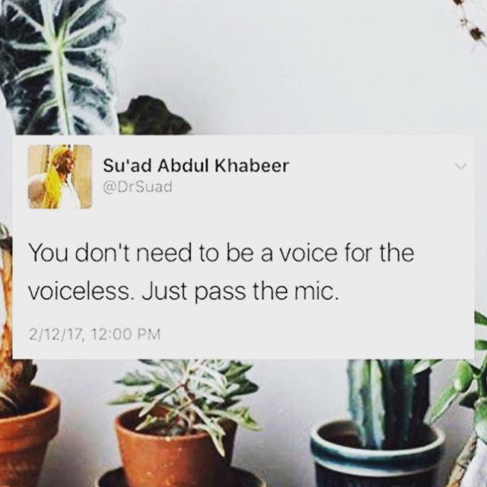

Slide 6
